Slide 1
LẬP TRÌNH TRÊN
MÔI TRƯỜNG WINDOWS
***
LINQ

Slide 2
Content
Introduction
Language Extensions
Standard Query Operators
LINQ providers
Khoa CNTT - ĐH KHTN

Slide 3
Introduction
It is a set of language changes and API's that allow you to write SQL-like queries natively in a .NET programming language.
LINQ allows you to obtain data in a consistent manner.
Apply to all sources of information, not just relational or XML data.
Khoa CNTT - ĐH KHTN

Slide 4
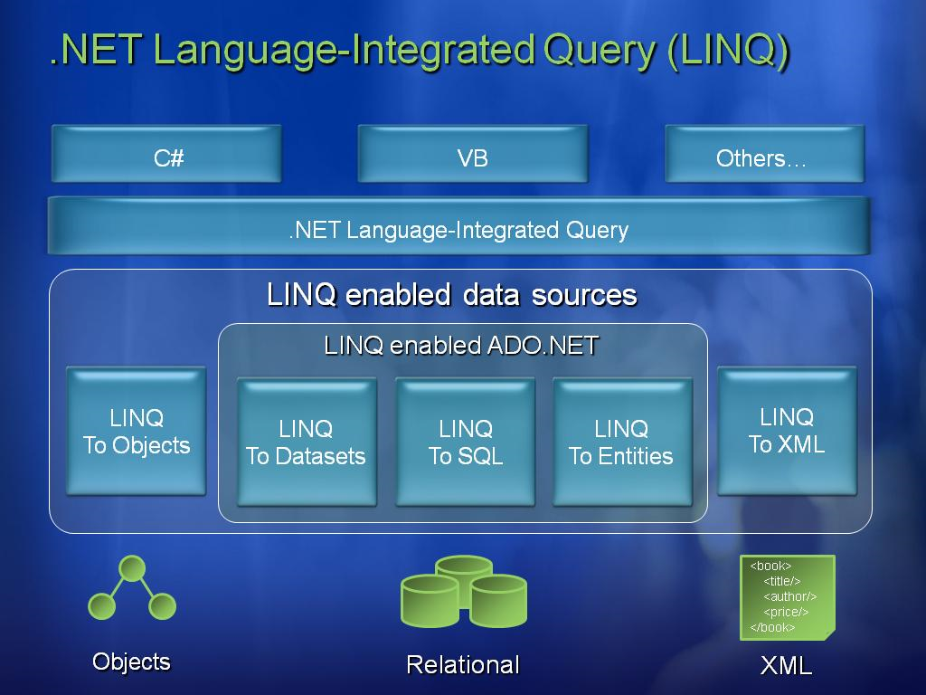
Introduction
Khoa CNTT - ĐH KHTN

Slide 5
Introduction
Some LINQ Namespaces
  System.Linq
  System.Linq.Expressions
  System.Data.Linq
  System.Xml.Linq
  …
Khoa CNTT - ĐH KHTN

Slide 6
Introduction
Example
public void Linq1()
{
int[] numbers = { 5, 4, 1, 3, 9, 8, 6, 7, 2, 0 };
var lowNums = from n in numbers where n < 5 select n;
Console.WriteLine("Numbers < 5:");
foreach (var x in lowNums)
{
Console.WriteLine(x);
}
}
Khoa CNTT - ĐH KHTN

Slide 7
Content
Introduction
Language Extensions
Standard Query Operators
LINQ providers
Khoa CNTT - ĐH KHTN

Slide 8
Language Extensions
Implicitly typed local variables
Object initializers
Anonymous types
Extension methods
Lambda expressions
Standard Query Operators
Query expressions
Khoa CNTT - ĐH KHTN

Slide 9
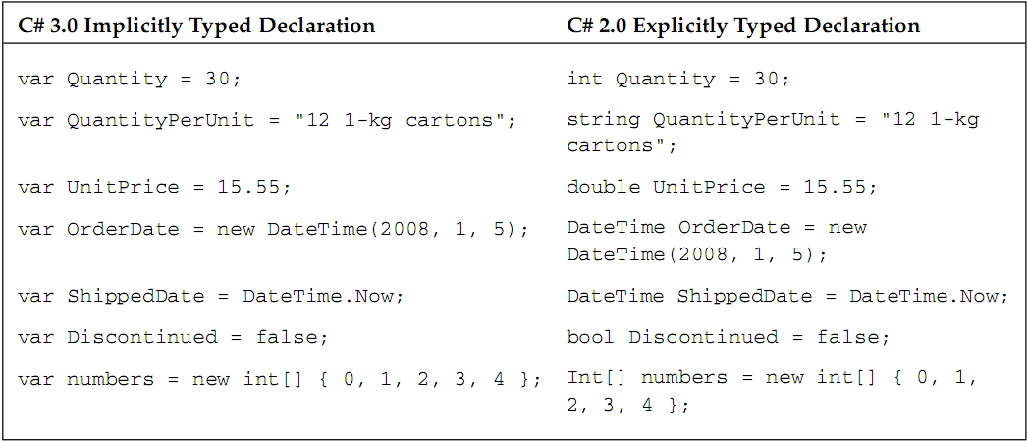
Language Extensions
Implicitly typed local variables
Khoa CNTT - ĐH KHTN

Slide 10
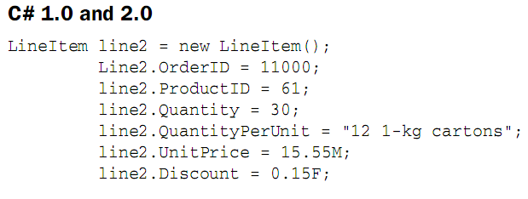

Language Extensions
Object Initializers
Khoa CNTT - ĐH KHTN

Slide 11
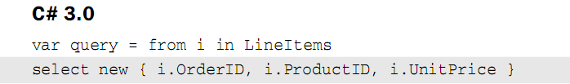
Language Extensions
Anonymous Types
  Are an abbreviated form of object initializers that let you omit the type specification when initializing temporary objects or collections.
Khoa CNTT - ĐH KHTN

Slide 12
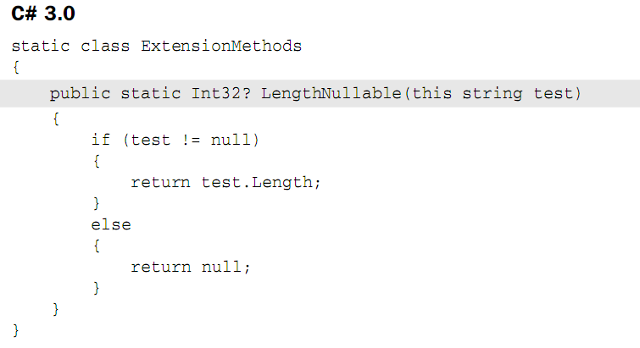
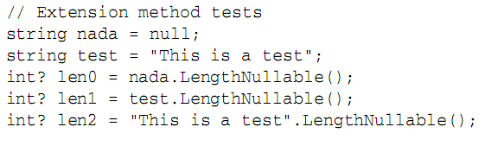
Language Extensions
Extension Methods
  Extension methods let you add custom methods to previously defined types.
Khoa CNTT - ĐH KHTN

Slide 13
Language Extensions
Lambda Expressions
  Provide developers with a convenient way to write functions that can be passed as arguments for subsequent evaluation.
  The basic syntax for lambda expressions
    argument-list = > expression-or-statement-block
  Example
    s => s.ToUpper();
string Func(string s)
{
return s.ToUpper();
}
Khoa CNTT - ĐH KHTN

Slide 14
Language Extensions
Standard Query Operators
  The standard query operators provide query capabilities including filtering, projection, aggregation, sorting and more.
  Some operators
    Select
    Where
    SelectMany
    Sum / Min / Max / Average
    OrderBy
    GroupBy
    Count
Khoa CNTT - ĐH KHTN

Slide 15
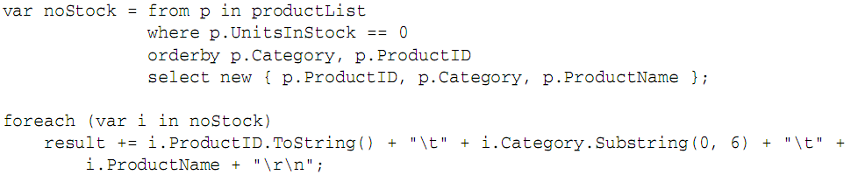
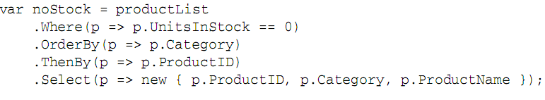
Language Extensions
Query Expressions
Compiler
Khoa CNTT - ĐH KHTN

Slide 16
Content
Introduction
Language Extensions
Standard Query Operators
LINQ providers
Khoa CNTT - ĐH KHTN

Slide 17
Standard Query Operators
Restriction operators
Projection operators
Partitioning operators
Join operators
Ordering operators
Grouping operators
Set operators
Element operators
Quantifiers
Aggregate operators
Khoa CNTT - ĐH KHTN

Slide 18
Standard Query Operators
Restriction operators
  Where
    x = products.Where(p => p.UnitPrice >= 10);
Khoa CNTT - ĐH KHTN

Slide 19
Standard Query Operators
Projection operators
  Select
    productNames = products.Select(p => p.Name);
  SelectMany
    orders =
    customers.
    Where(c => c.Country == "Denmark").
    SelectMany(c => c.Orders);
Khoa CNTT - ĐH KHTN

Slide 20
Standard Query Operators
Partitioning operators
  Take
    MostExpensive10 =
    products.OrderByDescending(p => p.UnitPrice).Take(10);
  Skip
    AllButMostExpensive10 =
    products.OrderByDescending(p => p.UnitPrice).Skip(10);
Khoa CNTT - ĐH KHTN

Slide 21
Standard Query Operators
Join operators
  Join
    var custOrders =
    customers.
    Join(orders, c => c.CustomerID, o => o.CustomerID,
    (c, o) => new { c.Name, o.OrderDate, o.Total }
    );
Khoa CNTT - ĐH KHTN

Slide 22
Standard Query Operators
Ordering operators
  OrderBy / ThenBy
    orderedProducts1 =
    products.
    OrderBy(p => p.Category).
    ThenByDescending(p => p.UnitPrice).
    ThenBy(p => p.Name);
Khoa CNTT - ĐH KHTN

Slide 23
Standard Query Operators
Grouping operators
  GroupBy
    productsByCategory =
    products.GroupBy(p => p.Category);
Khoa CNTT - ĐH KHTN

Slide 24
Standard Query Operators
Set operators
  Distinct
    productCategories =
    products.Select(p => p.Category).Distinct();
  Union
  Intersect
  Except
Khoa CNTT - ĐH KHTN

Slide 25
Standard Query Operators
Element operators
  First
    string phone = "206-555-1212";
    Customer c = customers.First(c => c.Phone == phone);
  Last
  ElementAt
    Product thirdMostExpensive =
    products.OrderByDescending(p => p.UnitPrice).ElementAt(2);
Khoa CNTT - ĐH KHTN

Slide 26
Standard Query Operators
Quantifiers
  Any
    bool b =
    products.Any(p => p.UnitPrice >= 100 && p.UnitsInStock == 0);
  All
  Contains
Khoa CNTT - ĐH KHTN

Slide 27
Standard Query Operators
Aggregate operators
  Count
    int count = customers.Count(c => c.City == "London");
  Sum
  Min
  Max
  Average
Khoa CNTT - ĐH KHTN

Slide 28
Content
Introduction
Language Extensions
Standard Query Operators
LINQ providers
Khoa CNTT - ĐH KHTN

Slide 29
LINQ providers
LINQ Providers
  LINQ to Objects
  LINQ to XML
  LINQ to SQL
  LINQ to DataSets
  …
Khoa CNTT - ĐH KHTN

Slide 30
LINQ providers
LINQ to Object
  LINQ to Objects allows .NET developers to write “queries” over collections of objects.
  Example:
int[] nums = new int[] {0,4,2,6,3,8,3,1};
int result = nums.Sum();
Console.WriteLine(result);
------------------------------------------------------
Output: 27
Khoa CNTT - ĐH KHTN

Slide 31
LINQ providers
  LINQ to XML
  LINQ to XML is a new way to construct, write and read XML data in the .NET languages.
  This new API simplifies working with XML data without having to resort to using additional language syntax like XPath or XSLT.
  Key classes:
    XDocument
    XElement
    XAttribute
Khoa CNTT - ĐH KHTN

Slide 32
LINQ providers
LINQ to XML
  Example
XDocument loaded = XDocument.Load(@"C:\contacts.xml");
var q = from c in loaded.Descendants("contact")
where (int)c.Attribute("contactId") < 4
select (string)c.Element("firstName") + “ “ + (string)c.Element("lastName");
foreach (string name in q)
Console.WriteLine("Customer name = {0}", name);
------------------------------------------------------------------------------
Output: Customer name = Barney Gottshall
Customer name = Armando Valdes
Khoa CNTT - ĐH KHTN

Slide 33
LINQ providers
LINQ to SQL
  is a component of .NET Framework 3.5 that provides a run-time infrastructure for managing relational data as objects.
  allows .NET developers to write “queries” in their .NET language of choice to retrieve and manipulate data from a SQL Server database.
  LINQ to SQL supports rapid development of applications that query Microsoft SQL Server databases using objects that map directly to SQL Server schemas.
Khoa CNTT - ĐH KHTN

Slide 34
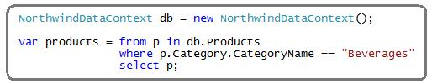
LINQ providers
LINQ to SQL
  Example
Khoa CNTT - ĐH KHTN

Slide 35
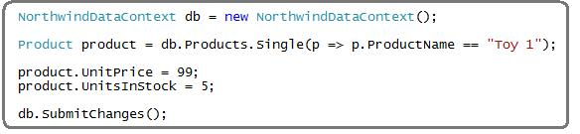
LINQ providers
LINQ to SQL
  Example:
Khoa CNTT - ĐH KHTN

Slide 36
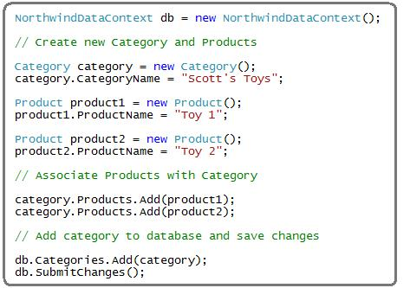
LINQ providers
LINQ to SQL
  Example:
Khoa CNTT - ĐH KHTN

Slide 37
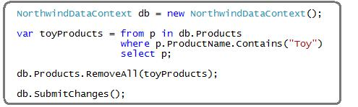
LINQ providers
LINQ to SQL
  Example:
Khoa CNTT - ĐH KHTN

Slide 38
LINQ providers
LINQ to DataSets
  LINQ to DataSet allows developers to write “queries” over existing DataSet sources within applications.
  Example
DataTable orders = ds.Tables["SalesOrderHeader"];
var ordersQuery = orders.ToQueryable();
var query = from o in ordersQuery
where o.Field<bool>("OnlineOrderFlag") == true
select new { SalesOrderID = o.Field<int>("SalesOrderID"),
OrderDate = o.Field<DateTime>("OrderDate") };
Khoa CNTT - ĐH KHTN

Slide 39
Khoa CNTT - ĐH KHTN

